Slide 1
The richest women in the world
Made by: réka gótzy, benedek bogárdi and máté auer
Group 8/1

Slide 2
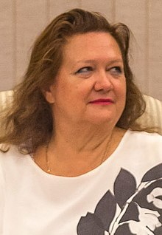
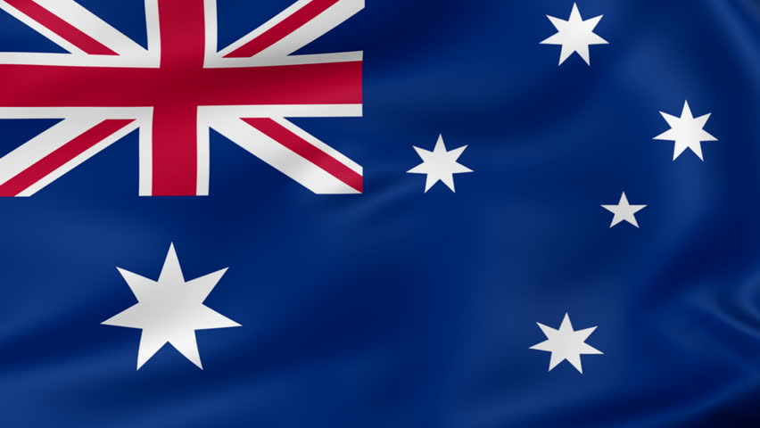
10. GINA RINEHART $13.1 BILLION
Australia's richest citizen built her wealth on iron ore.
In May 2019, a high court ruled that her longtime litigation with two of her children and Wright Prospecting could be settled behind closed doors.
The daughter of high profile iron-ore explorer Lang Hancock, Gina took her late father's bankrupted estate and rebuilt it into something much larger.
The biggest piece of her fortune comes from the Roy Hill mining project, which started shipments to Asia in 2015.
The mining magnate is also Australia's third-largest cattle producer, with a portfolio of properties across the country.
Since 2010 Rinehart has been actively promoting the cause of development of Australia's north and has spoken, written articles and published a book on this topic.

Slide 3
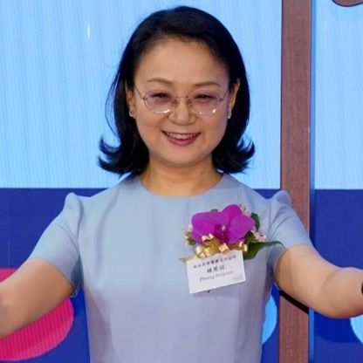
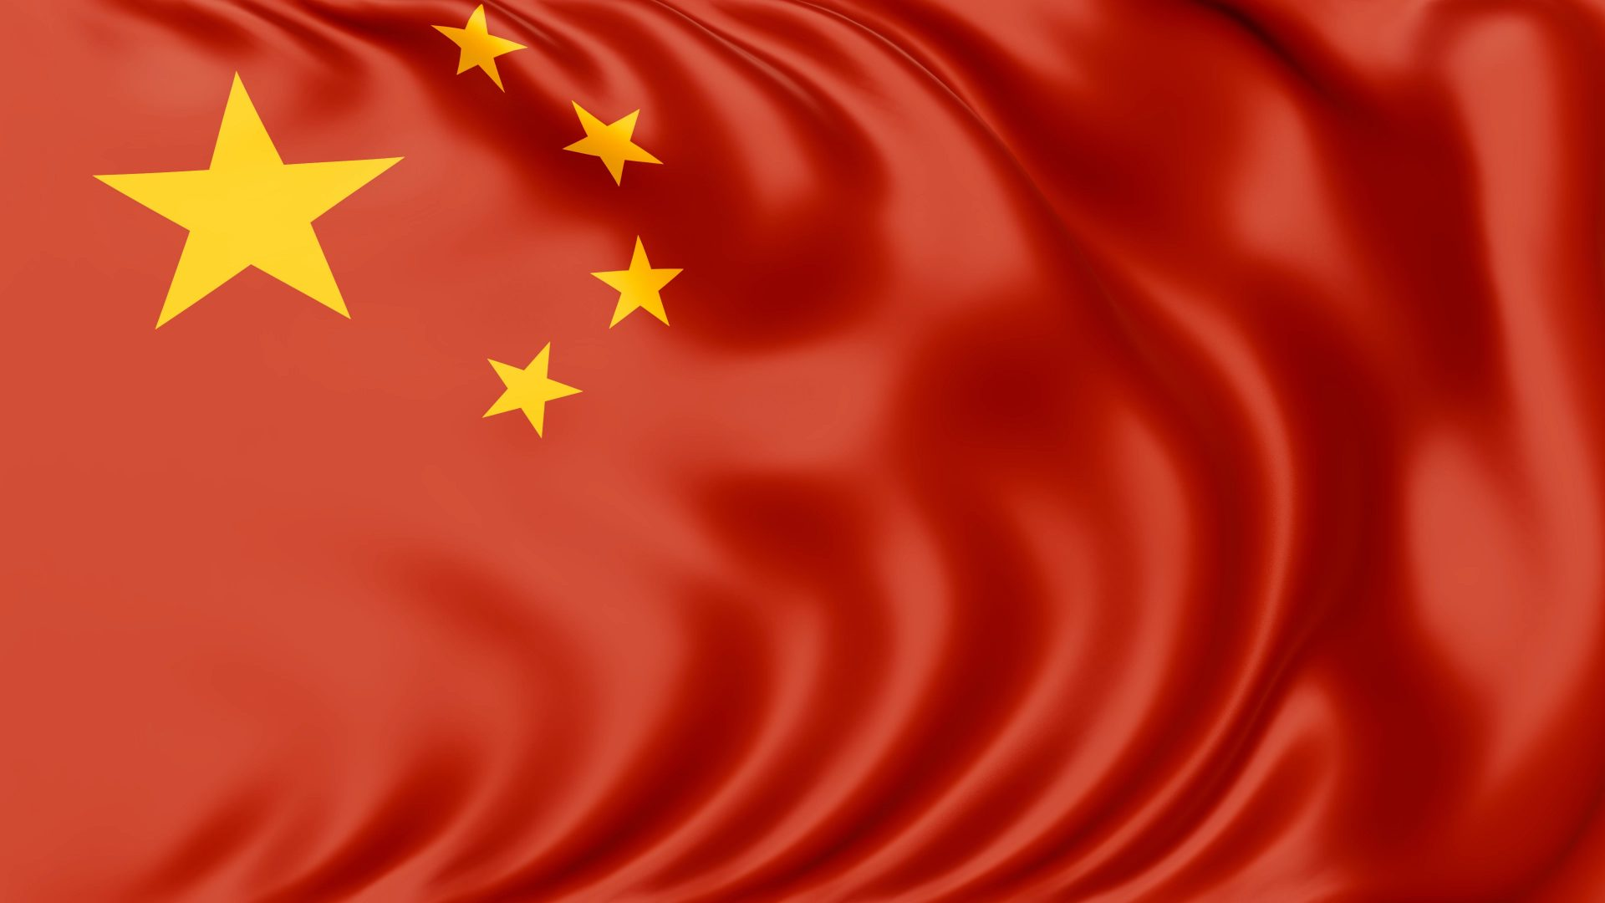
9. ZHONG HUIJUAN $14.6 BILLION
Zhong Huijuan chairs Chinese drugmaker Hansoh Pharmaceutical, which produces oncology, psychoactive, antidiabetic and other drugs.
Zhong's husband, Sun Piaoyang, is also a pharmaceuticals billionaire and leads Shanghai-listed Jiangsu Hengrui Medicine.
Zhong owns over three quarters of Hansoh Pharmaceutical with their daughter, Sun Yuan.
Headquartered in the Chinese coastal city of Lianyungang, Hansoh went public on the Hong Kong Stock Exchange in June 2019.

Slide 4
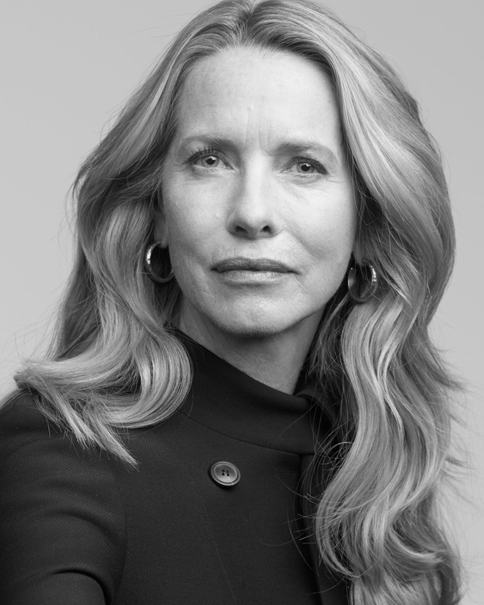
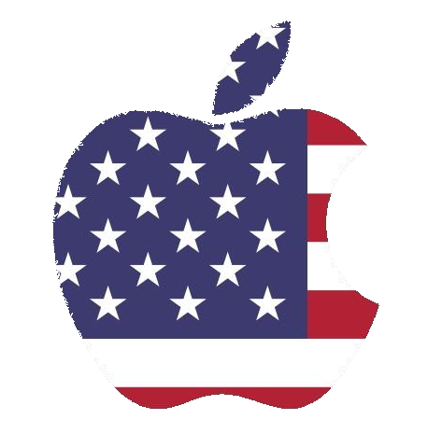
8. LAURENE POWELL JOBS $18.4 BILLION & FAMILY
Laurene Powell Jobs inherited billions of dollars of stock in Apple and Disney from her late husband, Apple cofounder Steve Jobs.
In 2017, she bought a minority stake in the parent of the NBA's Washington Wizards and the NHL's Washington Capitals.
She's also purchased stakes in several media outlets, including a majority of The Atlantic magazine and all of California Sunday and Popup Magazine.
She has been putting her fortune to work through Emerson Collective, a hybrid investment, social impact and philanthropic firm she founded in 2004.
She launched the Emerson Collective Foundation during the second half of 2016 with a gift of $1.2 billion, much of it in Disney shares.

Slide 5
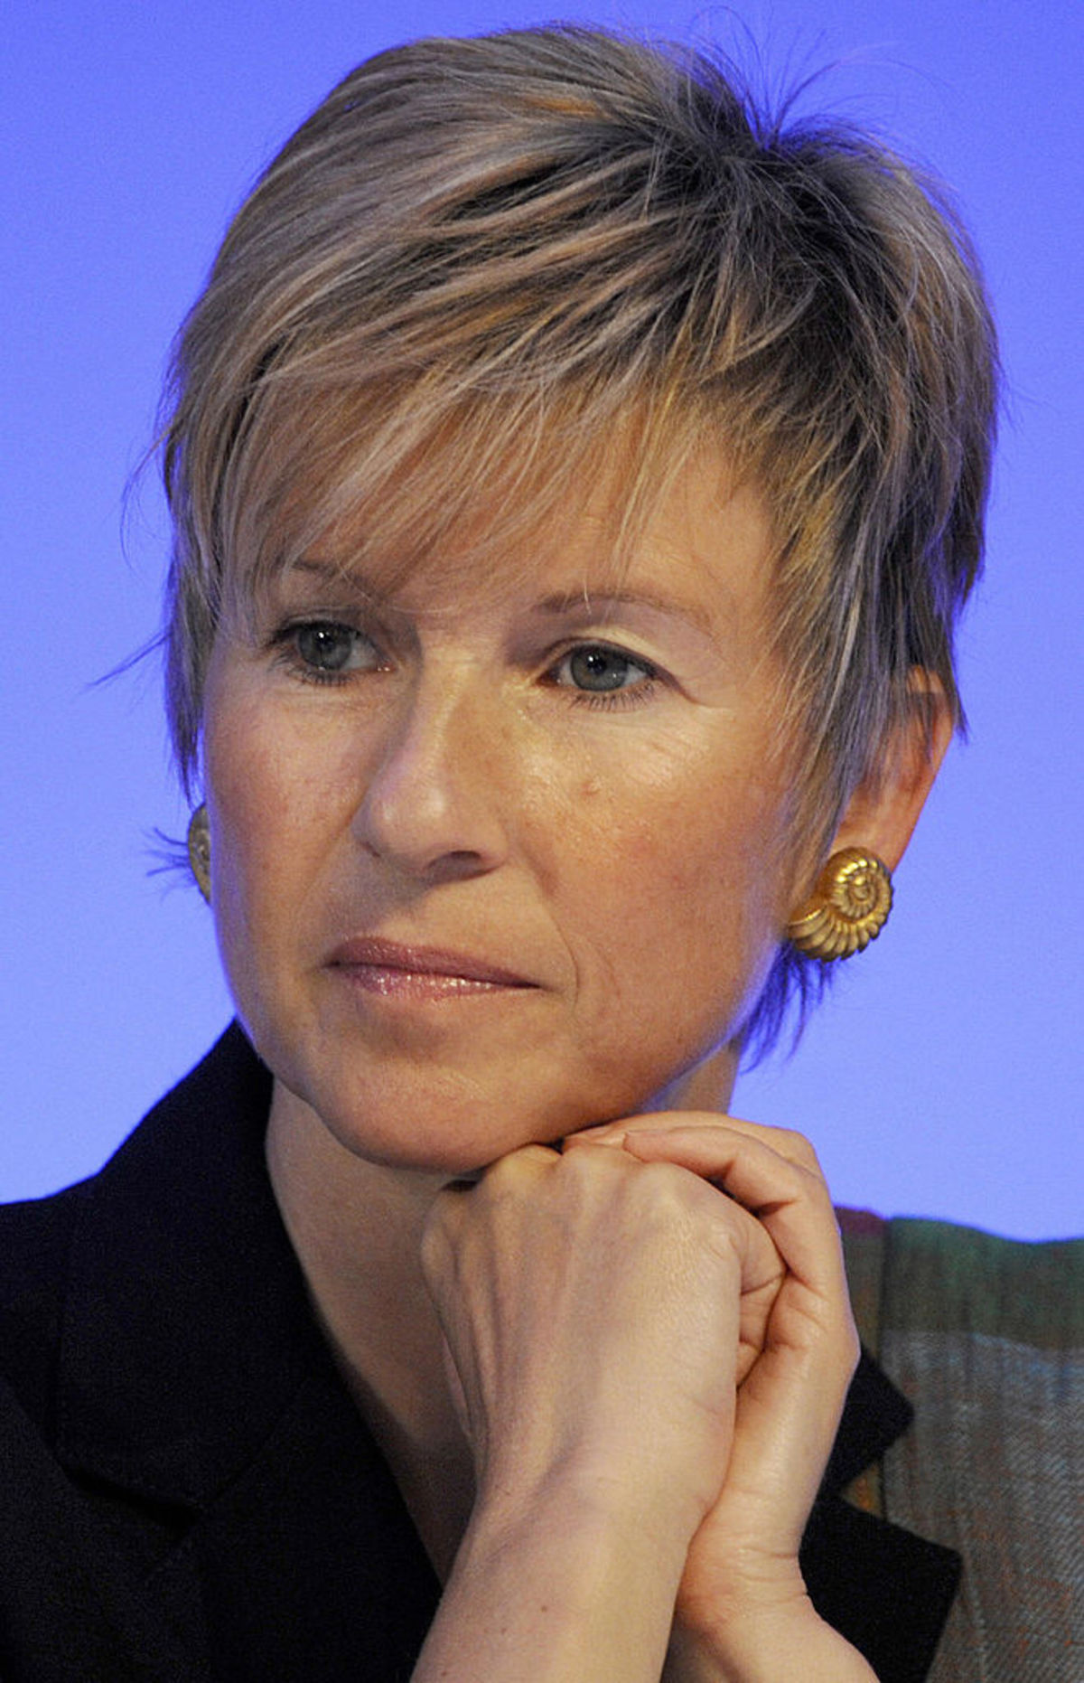
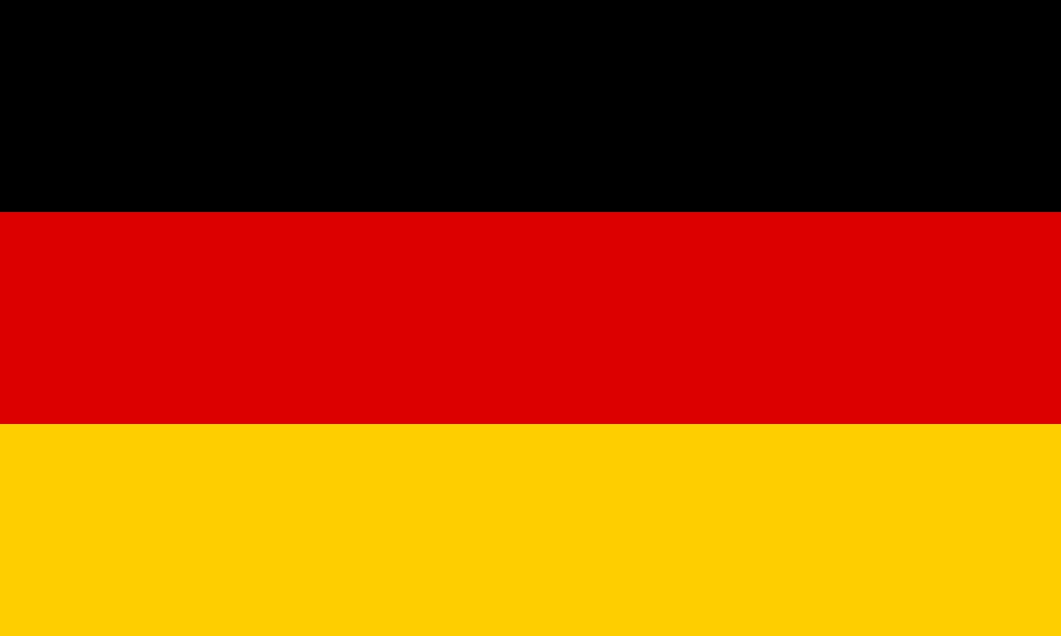
7. SUSANNE KLATTEN $19.7 BILLION
Susanne Klatten owns 19.2% of automaker BMW; her brother, Stefan Quandt, owns 23.7%.
Their late mother, Johanna, was the third wife of legendary industrialist Herbert Quandt, who guided BMW to preeminence in the luxury market.
An economist with an M.B.A., Klatten helped transform her grandfather's Altana AG into a world-class pharmaceutical/specialty chemical corporation.
Klatten is the sole owner and deputy chairman of Altana, which pulls in more than $2.5 billion in annual sales.
She also holds stakes in wind power outfit Nordex AG and carbon and graphite producer SGL Group.

Slide 6
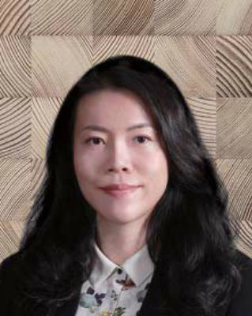
6. YANG HUIYAN & FAMILY $25.3 BILLION
Yang Huiyan owns 57% of real estate developer Country Garden Holdings, a stake largely transferred to her by her father Yeung Kwok Keung in 2007.
Yang's younger sister Ziyang also sits on Country Garden's board.
Yang chairs Bright Scholar Education Holdings, a Chinese education company that went public on the New York Stock Exchange in 2007.
Yang's aunt, Yang Meirong, holds a stake in Bright Scholar and was a member of the 2017 Forbes China Rich List.
Yang holds a degree from Ohio State University.

Slide 7
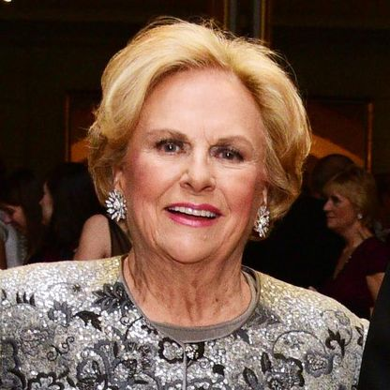
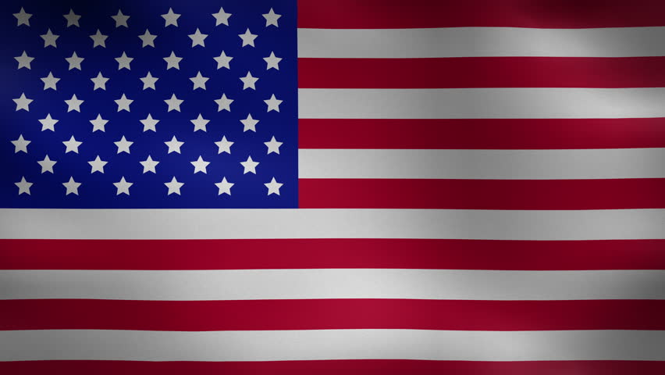
5. JACQUELINE MARS $27.7 Billion
Jacqueline Mars owns an estimated one third of Mars, the world's largest candymaker, founded by her grandfather.
She worked for the company for nearly 20 years and served on the board until 2016.
Her son Stephen Badger is chairman of Mars' board of directors.
A well-known philanthropist, she serves on six boards including at the Smithsonian and the National Archives.
Her brother John owns an estimated third of Mars; her late brother Forrest Jr's. four daughters own the rest.

Slide 8
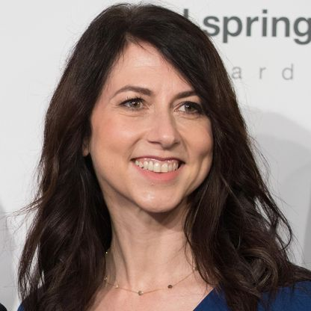
4. MACKENZIE BEZOS $46.6 billion
MacKenzie Bezos is the ex-wife of Amazon founder Jeff Bezos, to whom she was married for 25 years. They divorced in mid 2019.
As part of the divorce settlement, Jeff transferred 25% of his Amazon stake to MacKenzie, which was 4% of the company.
In May 2019, shortly after she announced the terms of the divorce on Twitter, she signed the Giving Pledge.
MacKenzie and Jeff met in 1992 when they both worked at hedge fund D.E. Shaw. They married the next year and moved to Seattle in 1994.
Bezos, who has published two novels, was a student of author Toni Morrison at Princeton and worked as a research assistant for her.
In 2014, she founded Bystander Revolution, an anti-bullying organization.

Slide 9
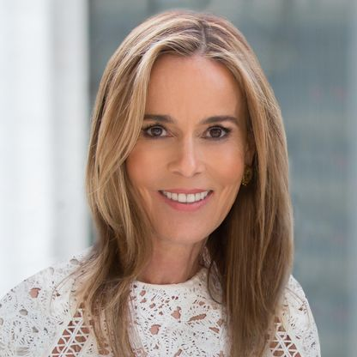
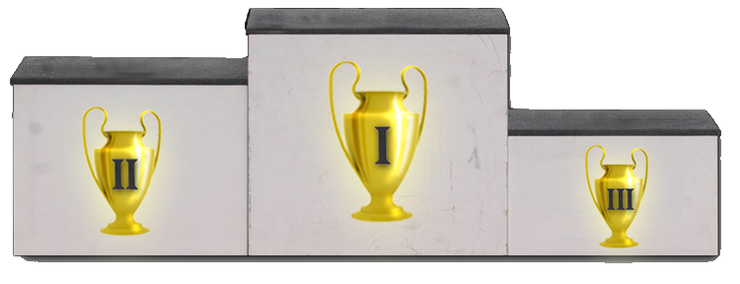
3. JULIA KOCH & FAMILY $47.5 Billion
Julia Koch and her three children inherited a 42% stake in Koch Industries from her husband, David, who died in August 2019 at age 79.
An Iowa native, Koch moved to New York City in the 1980s and worked as an assistant to fashion designer Adolfo.
She worked with many of his high-profile clients, including First Lady Nancy Reagan.
Julia met David via a blind date in 1991; they ran into each other again six months later, began dating and got married in 1996.
With her husband, she has donated $10 million to Mount Sinai Medical Center and $10 million to Stanford's Children's Hospital to study food allergies.

Slide 10
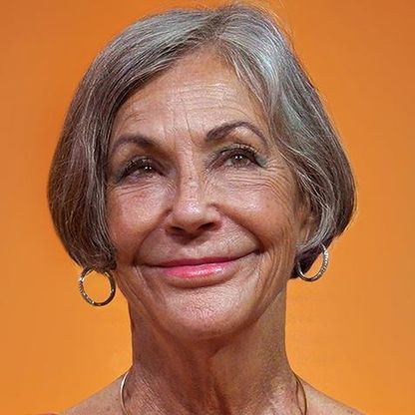
2.
ALICE WALTON
$54.1 BILLION
Alice Walton is the only daughter of Walmart founder Sam Walton.
She has focused on curating art, rather than working for Walmart like her siblings, Rob and Jim.
In 2011 she opened the Crystal Bridges Museum of American Art in her hometown, Bentonville, Arkansas.
Crystal Bridges features works from the likes of Andy Warhol, Norman Rockwell and Mark Rothko.
She and brother Jim are spearheading a program that will issue $300 million in bonds to help charter schools invest in facilities.

Slide 11
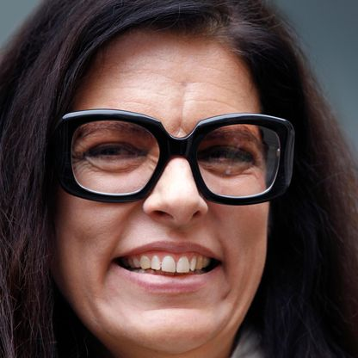
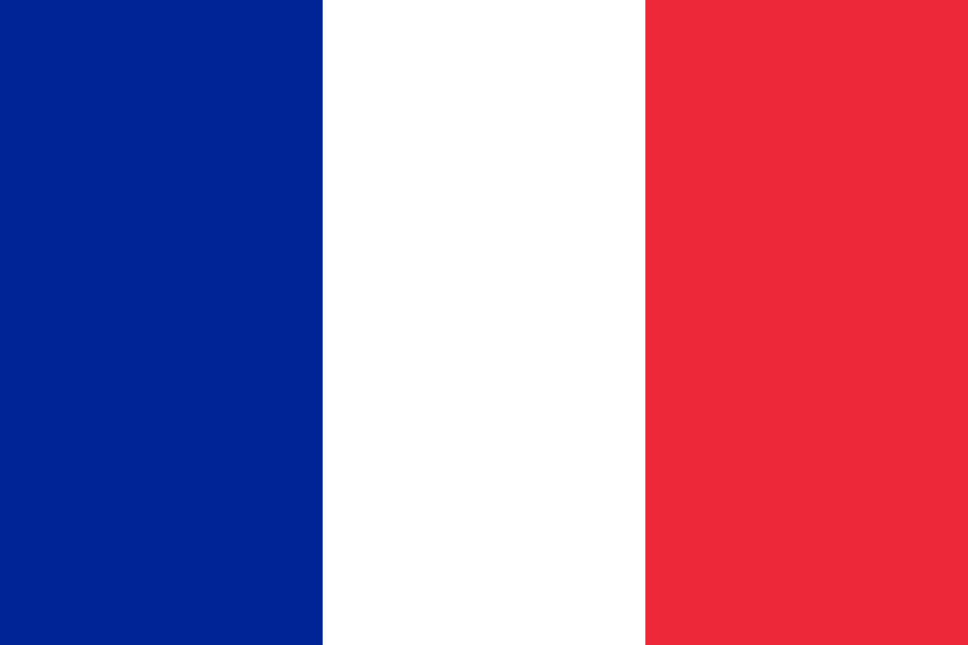
FRANCOISE BETTENCOURT MEYERS & FAMILY
1.
$57.2 BILLION
Francoise Bettencourt Meyers is the richest woman in the world and the granddaughter of L'Oreal's founder.
Bettencourt Meyers and her family own 33% of L'Oreal stock, which recorded its best sales growth in more than a decade in 2019.
She has served on L'Oreal's board since 1997 and is chairwoman of the family holding company.
She became France's reigning L'Oreal Heiress in 2017 when her mother Liliane Bettencourt, then the world's richest woman, died at age 94.
Bettencourt Meyers serves as the president of her family's philanthropic foundation, which encourages French progress in the sciences and arts.
Togther, L'Oreal and the Bettencourt Meyers family agreed to donate $226 million to repair Notre Dame cathedral following the April 2019 fire.

